Slide 1

Visualizing & Forecasting Residential Energy Data
Jennifer Brosnahan

Slide 2

Background
A law firm has contacted IOT Analytics to conduct an in-depth analysis of power consumption data for a residential home.
The law firm’s client claims to have not been occupying a specific residence at the time of an undisclosed event during Summer of 2008.
The law firm is collecting evidentiary proof points of residential energy use records from 2007 to 2010.

Slide 3

Business Objectives
Conduct in-depth analysis of power use by sub-meter for residential home from 2007 to 2010.
Visualize energy use patterns on high level (3-year time period) and precise-level (during Summer of 2008).
Use electrical power data from 2007 through 2009 to forecast energy use by sub-meter into 2010.
Discover insights from visualizations and forecasts.

Slide 4
Data Description
Data consists of energy consumed per minute for 3 different sub-meters in residential home from 2007 through 2009
1,569,894 total minute observations
Energy amount used each minute for each of 3 sub-meters:
Sub-meter 1: Kitchen (dishwasher, oven, microwave)
Sub-meter 2: Laundry (washing machine, drier, fridge, light)
Sub-meter 3: Electric Water Heater and AC

Slide 5
Summary of Energy Use by Sub-Meter (2007 to 2010)
Sub-meter 1: Kitchen
Least total energy used (1,819,989 Watts)
Average 1.16 Watts per minute
Largest energy range (0-82 Watts)
Sub-meter 2: Laundry
Total energy used (2,108,410 Watts)
Average 1.34 Watts per minute
Energy range (0-78 Watts)
Sub-meter 3: Water Heater & AC
Most total energy used (9,758,843 Watts)
Average 6.21 Watts per minute
Smallest energy range (0-32 Watts)

Slide 6
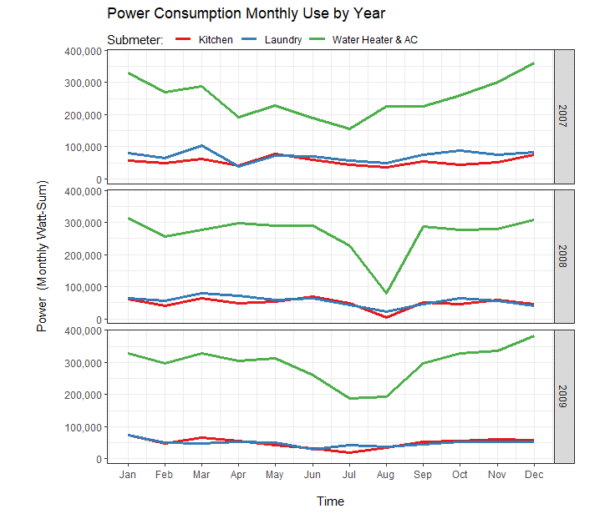
Seasonal Patterns: Monthly Energy Use Across 3 Years
Water Heater & AC consistently use more energy than other sub-meters across years
Seasonal patterns show peak energy use for Water Heater & AC in winter months, with steady decline reaching lows in summer months
Sharp decline for all sub-meters seen in August 2008
Recommendation: Explore Summer 2008 dip

Slide 7
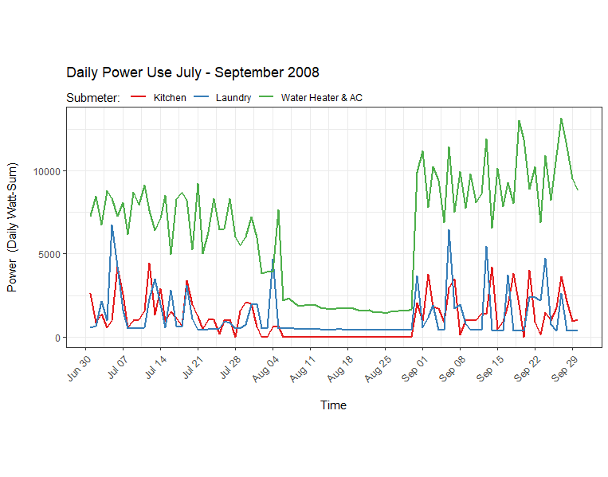
Summer 2008: Daily Energy Use from Jul-Sept 2008
Notice steep drop in energy use in all sub-meters from Aug 5-Aug 29, 2008
Water Heater & AC consistently use more energy than other sub-meters, even during August time period
Recommendation: Compare Summer months across years to see if 2008 is pattern or anomaly

Slide 8
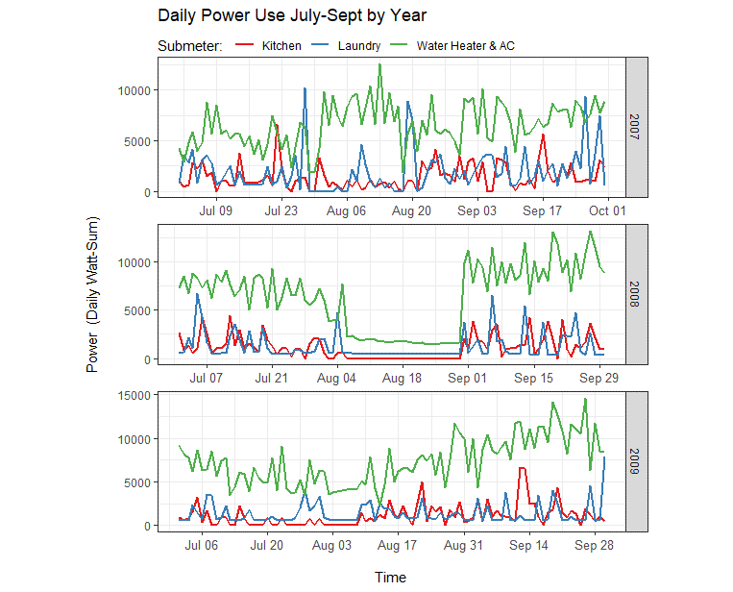
Summer Comparison: Daily Energy Use Jul-Sept by Year
Steep, extended drop in energy use is seen in Aug 2008 only
Water Heater & AC consistently uses more energy than other sub-meters across years
Less steep drop is seen for short duration beginning of Aug 2009
Recommendation: Explore on microscopic level weeks and days within August 2008

Slide 9
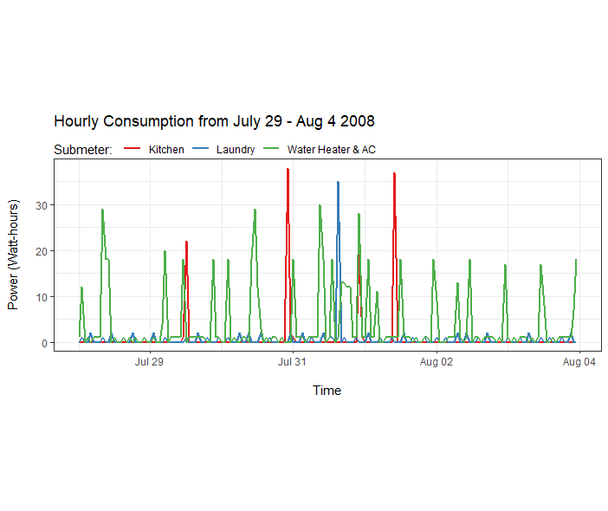
Hourly Energy Use for 1 week Jul 29-Aug 4 2008
Kitchen: used 4 times in 1 week period, 19-37 Watts/time
Laundry: 1 higher use of 35 Watts, otherwise 2-3 Watts regular intervals
Water Heater/AC: Range of 2-30 Watts used more frequently throughout the week
Recommendation: Explore hourly use the following week

Slide 10
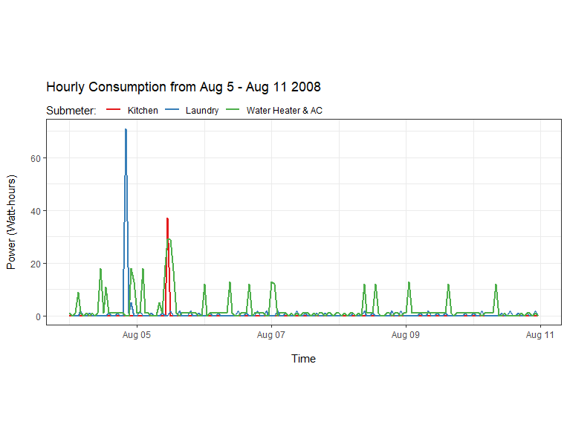
Hourly Energy Use for 1 Week: Aug 4-11 2008
Noticeable difference in energy use Aug 5 on.
Kitchen: reveals 1 spike of 39 Watts on Aug 5, with no more use
Laundry: 1 spike of 71 Watts late Aug 4. Can see 2-3 Watts intervals rest of week.
Water Heater/AC: High of 30 Watts occurred on Aug 5, followed by 1-2 Watt regular intervals with 12-Watt spikes about once/day
Recommendation: Explore hourly use the following week

Slide 11
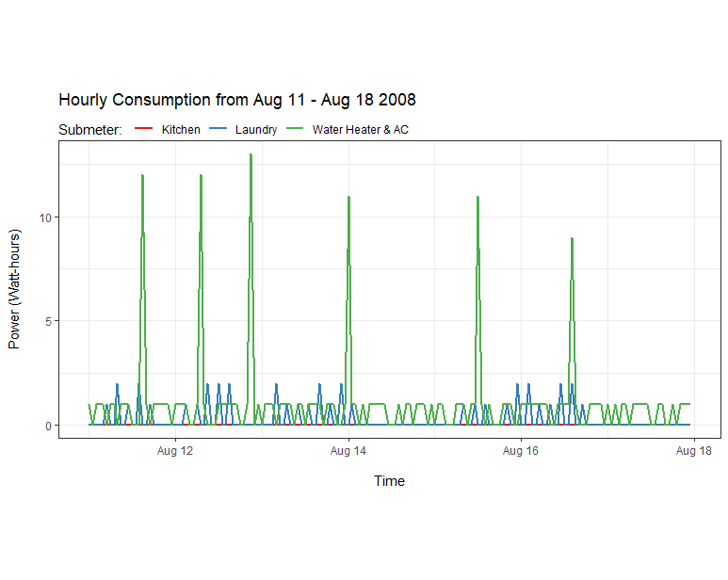
Hourly Energy Use for 1 Week: Aug 11-18 2008
Kitchen: Appears to be no energy use
Laundry: 1-2 Watts daily intervals, however, also notice time periods of no energy use
Water Heater/AC: 1-Watt regular intervals with 12-Watt spikes about once/day
Recommendation: Explore hourly use the following week

Slide 12
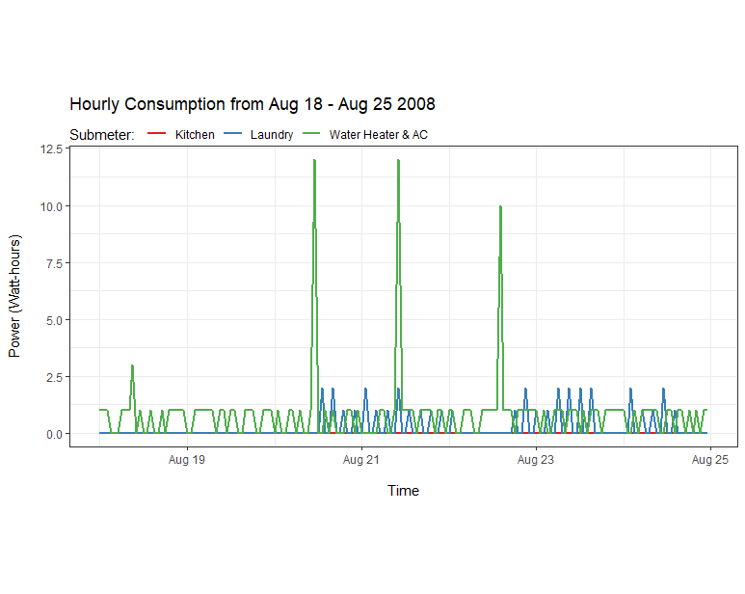
Hourly Energy Use for 1 Week: Aug 18-25 2008
Kitchen: Appears to be no energy use
Laundry: Appears no energy used Aug 18-19, but used other days
Water Heater/AC: 1 Watt regular daily intervals, with some spikes
Recommendation: Explore hourly use Aug 18 to see if Laundry room sub-meter is used or not

Slide 13
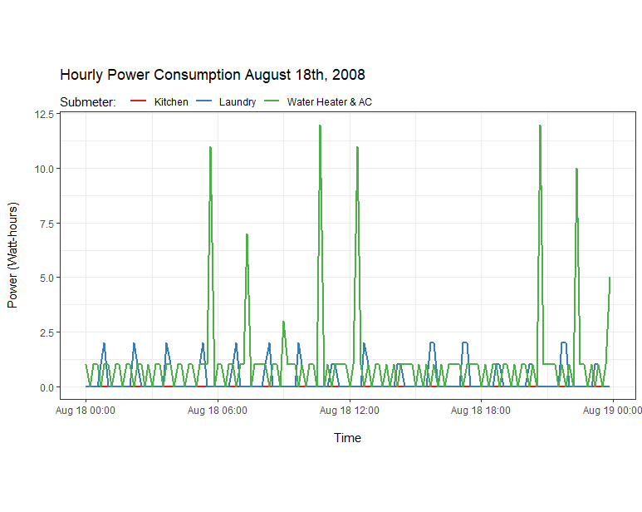
Hourly Energy Use for 1 Day: Aug 18, 2008
Kitchen: No energy used
Laundry: Reveals energy is being used at 1-2 Watt regular intervals
Water Heater/AC: 1-Watt hourly intervals with spikes throughout the day
Recommendation: Compare sub-meter energy use to another day in different time period

Slide 14
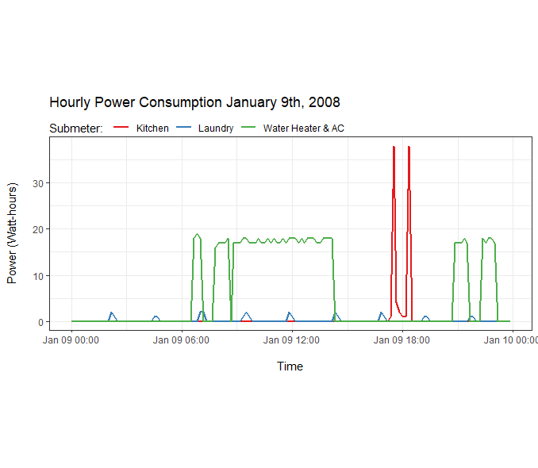
Hourly Energy Use for 1 Day: Jan 9, 2008
Energy use in kitchen indicates residence was occupied.
Laundry has same 1-2 Watt pattern as Aug 18, 2008.
Water Heater & AC consistently run during the day on this day in January

Slide 15
Top Insights from Energy Visualizations
Water Heater & AC sub-meter consistently uses more energy than other sub-meters, with regular spikes occurring most days
Seasonal patterns show peak energy use for Water Heater & AC in winter months, with steady decline reaching lows in summer months
Sharp extended decline for all sub-meters seen from Aug 5th-Aug 31st, 2008
No energy used from kitchen sub-meter during this time
Lower energy use from Laundry and Water Heater/AC sub-meters at regular intervals during this time
Although energy use is lowest in summer months, Aug 2008 sharp, extended decline is atypical of other years

Slide 16

Forecasting Energy Use into 2010
Utilize various forecasting techniques on each sub-meter to predict energy use into 2010:
Time Series Visualizations
Seasonal Forecasting Visuals
A Deeper Look at Seasonality, Trends, and Randomness in Energy Use
Non-Seasonal Forecasting

Slide 17
Time-Series Observation Frequency
Sub-meter 1 Kitchen: Collected 1 observation daily at 6:00pm
Sub-meter 2 Laundry: Collected 1 observation daily at 7:00pm
Sub-meter 3 Water Heater & AC: Collected 1 observation weekly on Monday at 8:00pm
Sub-meters 1 and 2 were collected more frequently since total use was significantly lower than Sub-meter 3

Slide 18
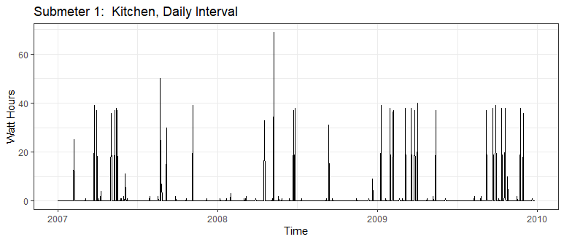
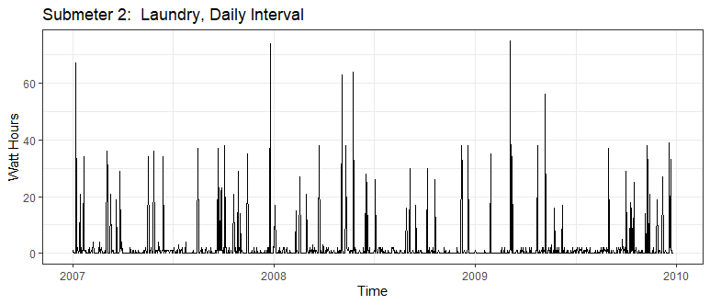
Time Series Visualizations 3-Year Period
Kitchen sub-meter
Less frequent spikes
Yields lowest total energy use (1,819,989 Watts)
Laundry sub-meter
More frequent spikes than kitchen
Yields slightly more total energy than kitchen (2,108,410 Watts)

Slide 19
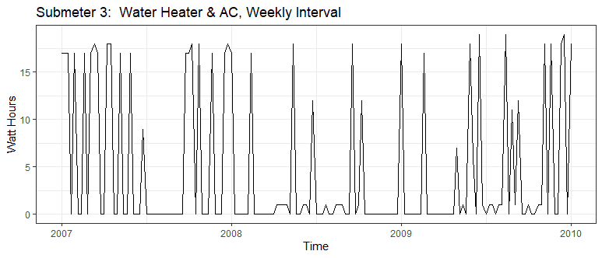
Time Series Visualizations 3-Year Period
Water Heater & AC
Collected on Weekly basis vs. Daily
Shows relatively consistent energy use over time
Some lulls in 2008

Slide 20
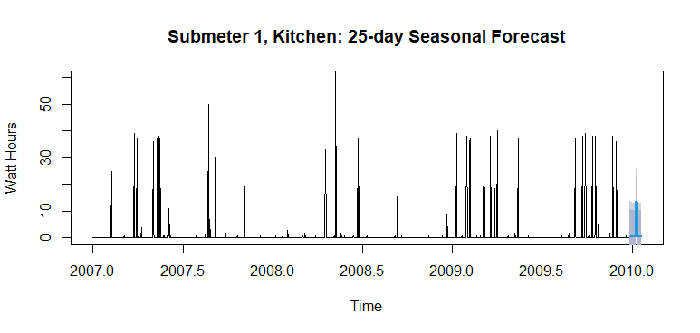
25-Day Seasonal Forecast
Sub-meter 1: Kitchen
Daily observation frequency at 6:00pm
3-year time period
80% confidence intervals ranges from -9.8 to 10.7 (negative values)
R2 (confidence): .313
RMSE (error): 6.56

Slide 21
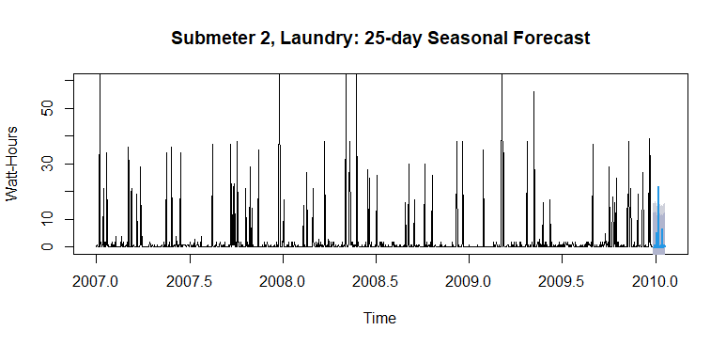
25-Day Seasonal Forecast
Sub-meter 2: Laundry
Daily observation frequency at 7:00pm
3-year time period
80% confidence interval ranges from -12.7 to 33.7 (negative values)
R2 (confidence): .334
RMSE (error): 7.91

Slide 22
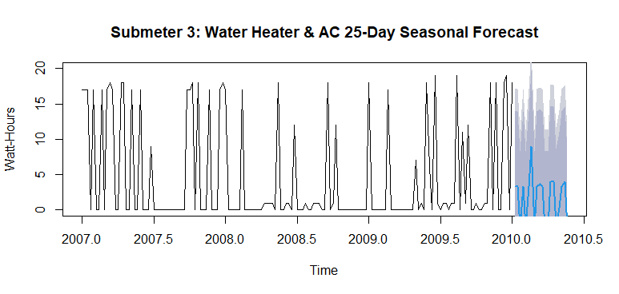
25-Day Seasonal Forecast
Sub-meter 3: Water Heater & AC
Weekly observation frequency, Mondays at 8:00pm
3-year time period
80% confidence interval ranges from -13.1 to 20 (negative values)
R2 (confidence): .358
RMSE (error): 7.08

Slide 23
25-Day Seasonal Forecast: R2 & RMSE
 | R2 | RMSE | 80% low | 80% high
Kitchen | .313 | 6.56 | -9.8 | 10.7
Laundry | .334 | 7.91 | -12.7 | 33.7
Water Heater/AC | .358 | 7.08 | -13.1 | 20
R2 (confidence): the closer to 1.0, the better
RMSE (error): the lower it is to 0, the better
Overall, the forecast for sub-meter 3 is most accurate
All predicted negative values

Slide 24
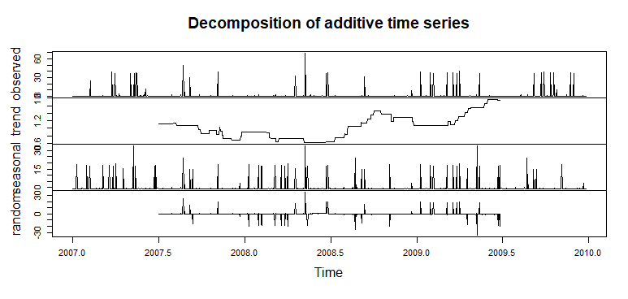
Trend, Seasonality, and Randomness Breakdown
Kitchen Sub-meter 1
Trend reveals steady decline from 1.1 mid-2007 to low of 0.6 mid-2008 then rise to 1.8 mid-2009
Reveals seasonality
Reveals some randomness

Slide 25
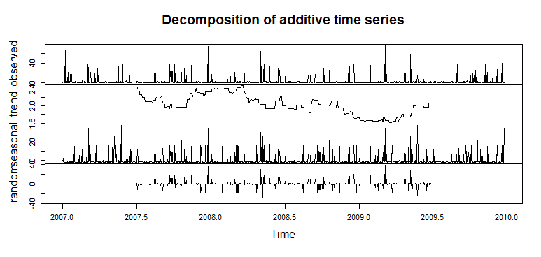
Trend, Seasonality, and Randomness Breakdown
Laundry Sub-meter 2
Trend reveals decline from high of 2.4 March 2008 to low of 1.6 in March 2009, then rise to 2.1 mid-2009
Reveals significant seasonality
Reveals some randomness

Slide 26
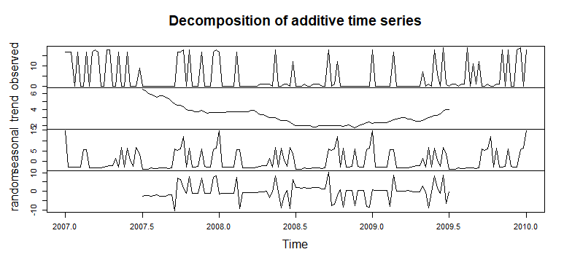
Trend, Seasonality, and Randomness Breakdown
Water Heater & AC Sub-meter 3
Trend reveals steady decline from high of 6 mid-2007 to low of 1 late-2008, then increase to 4 mid-2009
Seasonal effects show decreased use Q3s and peak use Q1s
Reveals some randomness

Slide 27
Trend, Seasonality, and Randomness
 | Seasonal | Trend | Random | Observations
Kitchen | 1090 | 1090 | 1090 | 365
Laundry | 1090 | 1090 | 1090 | 365
Water Heater/AC | 157 | 157 | 157 | 52
Summary Statistics

Slide 28
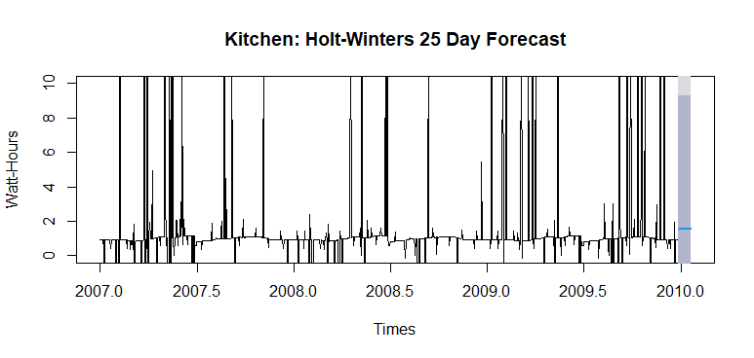
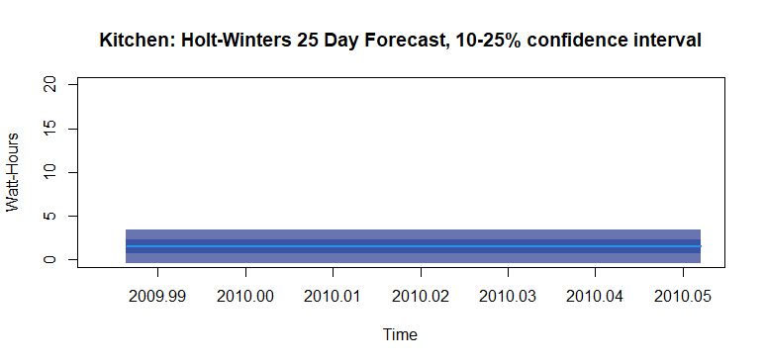
Non-Seasonal Forecasting: Sub 1 Kitchen
Holt-Winters: Seasonality is removed
Prediction trend is 1.52 Watts per minute (vs. 1.16 average 2007-2009)
Lower variance
No negative values

Slide 29
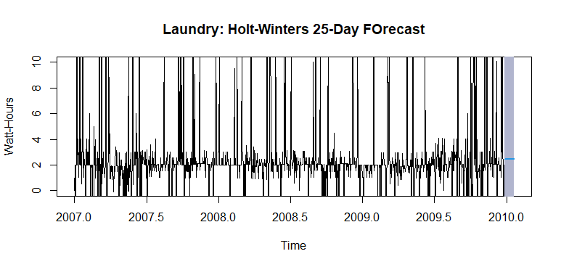
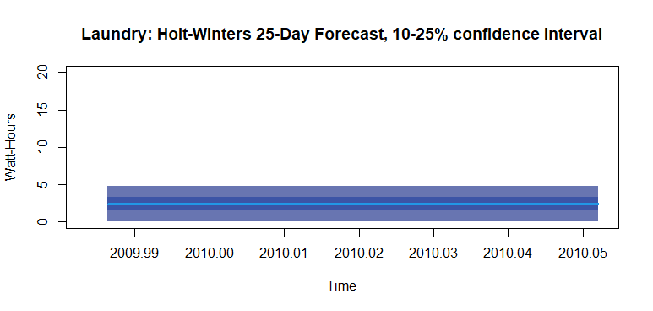
Non-Seasonal Forecasting: Sub 2 Laundry
Holt-Winters: Seasonality is removed
Prediction trend is 2.44 Watts (vs. 1.34 average from 2007-2009)
Lower variance
No negative values

Slide 30
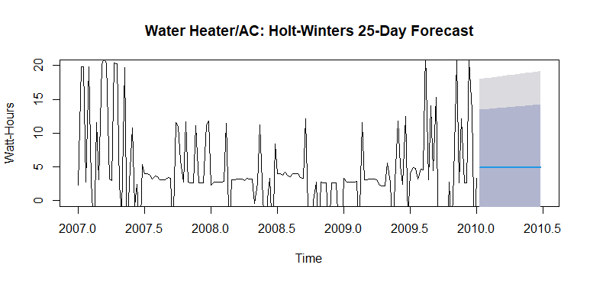
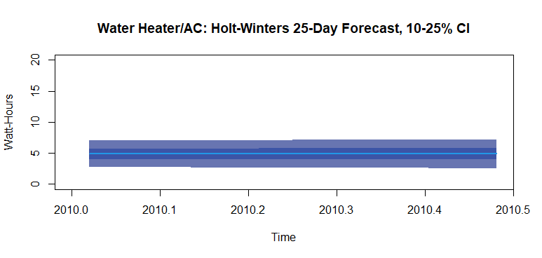
Non-Seasonal Forecasting: Water-Heater/AC
Holt-Winters: Seasonality is removed
Prediction trend is 4.89 Watts (vs. 6.21 average from 2007-2009)
Lower variance
No negative values

Slide 31

Top Insights from Energy Forecasting
Although Seasonal Forecasting (Linear Regression) accounted for variation through the years, it also predicted negative energy use values
Non-Seasonal Forecasting (Holt-Winters) had smaller variance, but no negative values
Forecasted energy use varies from average use by sub-meter:
Predicted Kitchen use is 0.36 Watts higher than average
Predicted Laundry use is 1.1 Watts higher than average
Predicted Water Heater/AC use is 1.32 Watts lower than average

Slide 32
Business Objectives
Conducted in-depth analysis of power use by sub-meter for residential home from 2007 to 2010.
Visualized energy use patterns on high level (3-year time period) and precise-level (during Summer of 2008).
Used electrical power data from 2007 through 2009 to forecast energy use by sub-meter into 2010.
Gained insights from visualizations and forecasts.

Slide 33

Energy Saving Recommendations
Reset HVAC controls to reduce daily Water Heater & AC spikes noted throughout the year to save energy
Reset AC thermometer in winter months to higher temperature setting to reduce energy use during peak season
Minimize sharp peaks in demand, as observed in July 2008, to cut energy costs
Takes steps to lower Kitchen and Laundry energy use in 2010, since forecasted use is higher than average.

Slide 34
Lessons Learned
DateTime is extremely difficult to pull apart, subset, and analyze
Tidyr gather() and Dplyr filter(), summarise(), group_by(), and %>% were lifesavers once I figured out how to use.
I prefer ggplot2 over plotly code from plan of attack. I found ggplot2 more efficient and fun.
Just when I was about to give up I finally discovered the code to label DateTime:
P <- scale_x_date(labels = date_format('%b %d'), breaks = date_breaks('1 day')) +
theme(axis.text.x = element_text(angle = 45, hjust = 1, vjust = 1, size = 8)) +

